Slide 1
KAR FREIGHT & FORWARDING LLC

Slide 2
AW ROSTAMANI GROUP

Slide 3
CONTENTS
Chairman Message
Introduction – KAR Freight & Forwarding
Core Values & Our Vision
Products & Services
Specialties & Value Added Services
KAR Strengths & Capabilities
KAR FF Business Processes & SOP
Synopsis of Jobs / Project Undertaken / Executed
TOP Customers
Advantages of Partnering with KAR FREIGHT & FORWARDING LLC.
KAR FREIGHT & FORWARDING LLC

Slide 4
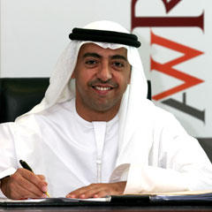
Chairman Message
KAR FREIGHT & FORWARDING LLC
KAR FREIGHT & FORWARDING LLC

Slide 5
INTRODUCTION
GROUP BUSINESS STRUCTURE
&
KAR FREIGHT & FORWARDING LLC
KAR TRANSPORT LLC
KAR FREIGHT & FORWARDING LLC

Slide 6
INTRODUCTION
KAR FREIGHT & FORWARDING LLC
KAR Freight & Forwarding LLC is an integrated logistics company associated with trusted AW Rostamani Group, Dubai, (www.awristamani.com). Our vision is to be an admired services provider. Our mission is to deliver what we promise and build long-term relationships with our stakeholders. We have a culture of team work responsible organizational and personal behavior, we encourage and facilitate free flow of ideas for continual improvement.
Supported by a network of partner worldwide with extensive local knowledge and distinct capabilities, KAR Freight & Forwarding LLC is able to provide you customized solutions to all your freight transport, storages, distributions and management need.
We assured the best of services & cooperation to all our estimated customer & stakeholders.
KAR FREIGHT & FORWARDING LLC

Slide 7
CORE VALUES
KAR FREIGHT & FORWARDING LLC, Vision is to be an admired services provider.
Our Mission is to deliver what we promise and build long-term relation with stakeholders.
We have culture of teamwork, responsible organizational and personal behavior.
Our people, their knowledge, experience & skills.
Our Desire for continual improvement through engagement and free flow of ideas.
KAR FREIGHT & FORWARDING LLC

Slide 8
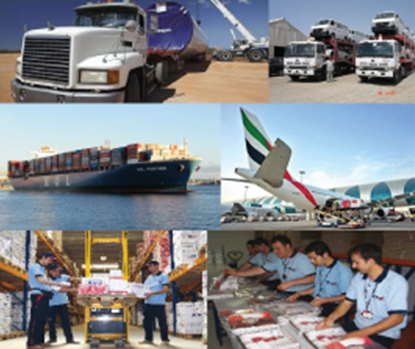
Products & Services
Air Freight
Sea Freight
Land Freight- International and Domestic
Warehousing Inside/Outside JAFZA
Removal & Relocation – Local & International (Offices & Home)
Customs Clearance
Cargo Insurance
Project Cargo
Automotive Logistics
Vehicle Stock Yard Management
Vehicle Clearance
Spare Part Distribution
Vehicle Import & Export
KAR FREIGT & FORWARDING, LLC

Slide 9
Specialties & value Added Services
WMS – Warehousing Management Services (60,863 SQ Meter)
Complete Supply Chain Solution for (African Continent)
Cross Trade for (CIS – Countries)
Industrial Packing & DGR Cargo Handling
Express Cargo (Group Age) – GCC
Reefer Trucking (split-Temperature)
Self Storage Facilities
Air Conditioned Warehousing Facilities.
Turnkey Project.
E-Custom Clearance
Custom Clearance & Documentation at (GCC Borders)
Vehicle Stock Yard.
End to END Supply Chain Solution for Automotive,
Logistics (Vehicle & Spare Parts)
KAR FREIGHT & FORWARDING LLC

Slide 10
KAR Strengths & Capabilities
Sea Freight – Import & Export
KAR Freight & Forwarding LLC. Containerized Full Container Load (FCL) & Less Than Container Loads (LCL), Import & Export, Door to Door Services, backed by a network of partners worldwide. Competitive rates through carriers Expertise and Experience in Movement to/from any origin till destination worldwide, excellent freight services TO/FM, USA , Europe, Africa, China, Australia, Iran, Iraq, Afghanistan & CIS countries Ex all UAE Ports.
Air Freight – Import & Export
KAR Freight & Forwarding LLC , Air freight division has strived to ensure that our pricing is the most competitive, while at the same time, making sure that at no time is quality of service compromised. The strength of this division lies in the expert manpower, which specialize in moving cargoes of special nature that are difficult to handle, like outsize, dangerous goods, etc.
Custom Brokerage
KAR Freight & Forwarding LLC is Registered custom clearance agent, Electronic clearance capabilities, custom related documentation collection & deliveries, to ensure one window services is our key mission
KAR FREIGHT & FORWARDING LLC

Slide 11
KAR Strengths & Capabilities
Groupage Cargo (Consoles), Sea & Air Freight
KAR Freight & Forwarding LLC, Offers Cargo receiving services at designated collection centers at origin ports, issue HAWB/HBL’s to the final destinations, load cargo to Dubai, UAE in Air/Shipping lines containers, De-Consolidation in (Dubai) free zones & re-distribute to the final destinations in Middle East, North Africa, India , Pakistan & Rest of the world.
Warehousing & Distribution
KAR Freight & Forwarding LLC & (AWR Logistics) provide warehouses in Jebel Ali Free Zone (Bonded) & Al Quoz, Dubai. Ambient, air conditioned and open storage facilities,
3rd party logistics services include inventory management, value additions, kitting (assembly), software
upgrades, labeling, and barcoding, and packaging, stock visibility through on-line computer system.
Specialist knowledge in operating cargo distribution hubs for all kinds of cargo (such as spare parts, computers, mobile – phones, white goods etc.,)Managing customer’s warehouses/distribution centers using own IT & human resources.
KAR FREIGHT & FORWARDING LLC

Slide 12
KAR Strengths & Capabilities
Specialized Packing
KAR Freight & Forwarding LLC Offers the Industrial packing to make Large / Small shipments ready for
transportation by air/sea or land supported by a team with hands on experience, packing done at customers
site or at our own warehouses.
Project, Heavy lift and Oversize Cargo
KAR Freight & Forwarding LLC Managing movement of plants & heavy machinery that pose complex logistical
challenges and require specialist knowledge, using single or multiple modes of transportations,
Ship & Air Craft Chartering
KAR Freight & Forwarding LLC having expertise in hiring ship and air craft for large volumes of cargo, contract
with reputed owners, brokers and operators offering services, professionally qualified staff with extensive
local knowledge on all Middle Eastern Ports
Shipping Agent
KAR Freight & Forwarding LLC, Offers Port agency services for liner and tramp vessels in Dubai, UAE. Regional
agency services for all Middle Eastern ports through a network of capable agents. Specialist services include
on/off shore crew handling, supplies & provisions (Ship Handling). Spare part logistics & bunkering.
KAR FREIGHT & FORWARDING LLC

Slide 13
KAR Strengths & Capabilities
Exhibition Services
KAR Freight & Forwarding LLC, offers Freight services for exhibits and support material from point of origin,
local customs and administrative clearances, assembly at site, general logistical support during the event
including warehousing, re-export to point of origin.
Logistics Procurement Services
KAR Freight & Forwarding LLC, Evaluate and select logistics suppliers as per customer’s selection criteria,
obtain quotation and provide feedback to customers, effect shipments on suppliers nominated by customers.
Benefits to customers include cost transparency and a single contact point for all logistical need.
Administrative Services
KAR Freight & Forwarding LLC, Offers Document legalization through bank & government ministries, assistance
for arranging cargo insurance, advice on “best practices” for managing logistics
Information Technology Solutions
Manageable and affordable information technology solutions to better manage the supply chain.
KAR FREIGHT & FORWARDING LLC

Slide 14
KAR Strengths & Capabilities
Professional Affiliations
National ASSOCIATION OF Freight and Logistics, Dubai (NAFL) www.nafl.ae
International Federation of Transport Associations (FIATA) www.fiata.com
World Cargo Alliance, Family of Logistics Networks (WCA) www.wcafamily.com/eng/
China Global Logistics Network (CGLN) www.cgln.net/eng/index/asp
International Association of Movers (IMA) www.imamovers.org/
KAR FREIGHT & FORWARDING LLC

Slide 15
KAR Strengths & Capabilities
KAR FF & KAR T, Partnership
KAR Transport, is one of the established road transport services provider in the GCC and member of KAR Group, KAR Freight & Forwarding LLC & KAR Transport LLC, have established a partnership as KAR - GROUP, to offer the combined capabilities of both organization to provide TOTAL TRANSPORTATION SOLUTION covering UAE and GCC.
KAR FF & KAR Transport, One of the road transport services provider in GCC, operates a varied fleet of state-of-art vehicles such as *Container Trailers (Flat Bed Trailers, Curtin Side Trailers , & Low Bed Trailers), * Car Carriers Services, (Multiple Car’s Carrier) * Single Car Recovery Services * 1 T / 3 T / 7 T & 10 T Delivery Trucks Services. KAR Transport. Uses state of art EPR systems such as oracle to manage its large road transport fleet, KAR Transport complements customers business by ensuring safe handling and timely delivery of shipments.
KAR FREIGHT & FORWARDING LLC

Slide 16
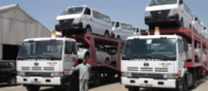
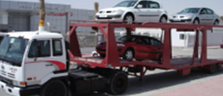
((The range of road transportation services includes))
KAR Transport LLC
Container Transportation
* KAR – T. Transport the full range of container type all over the UAE and GCC.
* Groupage
* For ‘less than full’ truck loads, KAR Transport operates scheduled Groupage services, consolidating shipments to various locations in the UAE.
Distribution
* A fleet of 3T delivery trucks plays a crucial role in just –in-time deliveries as part of total
Supply Chain Solutions for clients using KAR Transport ’ s distribution centers, Regular Twice Daily (Or More Frequently if required by customers) , deliveries are made to retail outlets and Customer premises all over the UAE, Inter-city or point-to-point, deliveries are routed, as and when necessary, through a central trans shipment hub in Dubai.
Specialized Road Transport Vehicles – Car Transportation / Carriers
* To meet the Specific requirements of Automotive Clients, KAR – T, operates modern fleet of Car Carrier of Different Capacities to Optimum flexibility in terms of speed, routing and types of load carried.
Automotive Supply Chain Solution
KAR Transport , can offer One-Stop-Ship Solution to Automotive Clients to manage Vehicle & Parts Logistics operations starting from shipment Tracking, Freight Forwarding, Customer Clearance & Documentation, Port operations, New car transportation, Stock Yard Management, PDI, & NEW Car’s delivery to all over the UAE & GCC. The KAR Transport, adds value by optimizing the deliveries, transportation planning, improving operational efficiencies, Turnaround time and cost reduction.
KAR Transport LLC
KAR Strengths & Capabilities
KAR FREIGHT & FORWARDING LLC

Slide 17
KAR - FF & KAR - T, Strengths & Capabilities
OUR FLEET / ACTIVITY & VOLUMES
TYPE OF EQUIPMENTS | NO OF VEHICLES
Trailers / Car Carriers | 16
Delivery Vans 1T / 3T | 41
Prime Mover | 11
Total Vehicles | 68
KAR - FF & KAR – T, VOLUMES
Service Type | Activity Type - Sub Group | Average Monthly | Yearly Movements
Land Transportation | Trailers / Car Carriers - Trips | 1,588 | 19,056
 | Local Deliveries - 3T / 1T - Trips | 2,281 | 27,372
Sea Freight | RoRo - Cars No's | 9,953 | 119,436
 | Containers - (20' & 40') | 236 | 2,832
Air Freight | Gross Weight (kgs) | 12,294 | 177,432
Customs Clearance | No. of documents cleared | 290 | 3,480
Removals & Relocation's | No. of Moves | 37 | 444
KAR FREIGHT & FORWARDING LLC

Slide 18
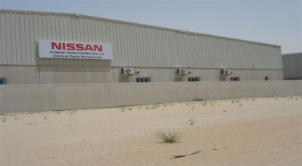
KAR Strengths & Capabilities
* NOD - Number of deliveries per day
Emex SHJ
NOD-1 per day, Kms-68
RAK
NOD-2 per day
Kms-174
Dibba
NOD-2 per day
Kms-222
KFK
NOD-2 per day
Kms-182
Fujairah
NOD-2 per day
Kms-162
Dhaid
NOD-2 per day
Kms-106
SHJ Branch
& Dealers
Time of Delivery- per day
Kms-84 Kms
Kalba
NOD-2 per day
Kms-177
UAQ
NOD- 1 per day
Kms-120
GHS Branch
& Dealers
NOD-2 per day
Kms-77 Kms
Ajman
NOD-2 per day
Kms-98
Courier Delivery
Awir
NOD-1 per day, Kms-50
DXB W/H
NOD-4 Per day
Kms-56
Al Ain
NOD-1 per day
Kms-185
CPD
Awir / KR
NOD-2 per day
Kms-50
SHJ Dealers
(BMW Road)
NOD-2 per day
Kms-76
SZR Branch
NOD-2 per day
Kms-32
SZR Dealers
NOD-2 per day
Kms-41
SHJ Dealers
(Cola Road)
NOD-2 per day
Kms-78
Satwa
NOD-2 per day
Kms-41
DXB Dealers
NOD- 2 per day
Kms-61
Abu Dhabi
NOD-1 per day
Kms-175
KR W/H
NOD-3 per day
Kms-47
Awir (S02)
NOD-3 per day
Kms-47
Awir (S14)
NOD-3 per day
Kms-47
KAR FREIGHT & FORWARDING LLC

Slide 19
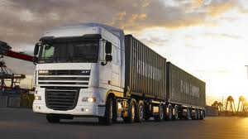
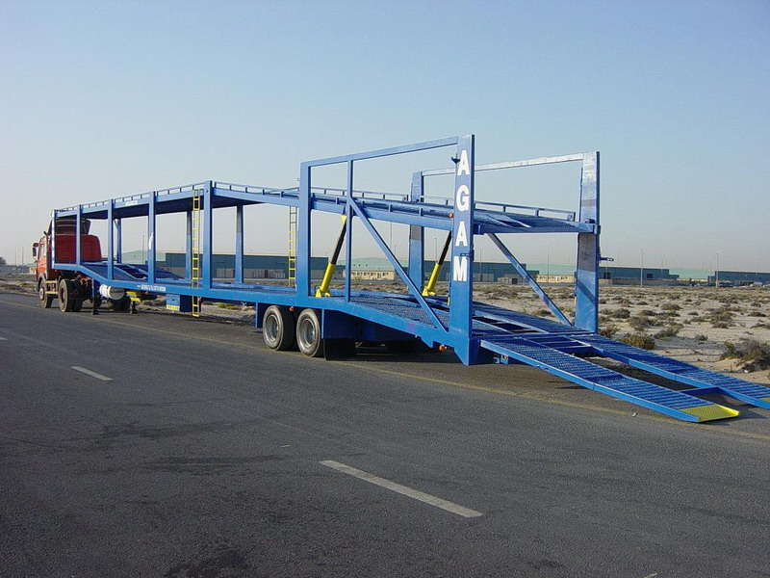
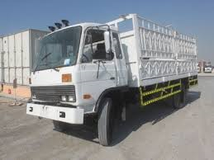
KAR TRANSPORT, LLC OWN FLEET’S
111111111111111111111111111111111111111111111111111111111111111111111
11111111111111111111111111111111111111111111111111111111111111111111111111
KAR Strengths & Capabilities
KAR FREIGHT & FORWARDING LLC

Slide 20
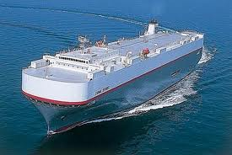
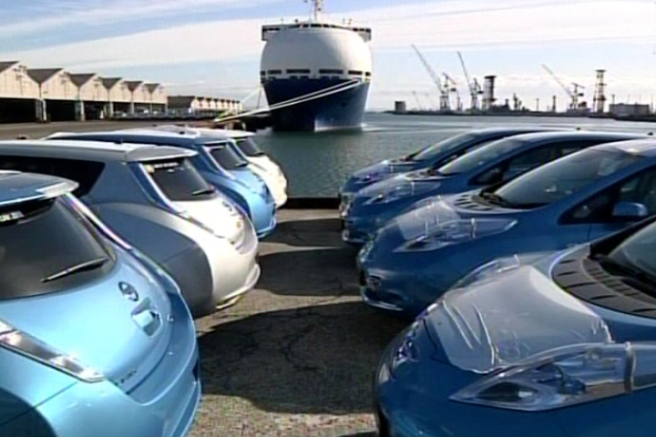
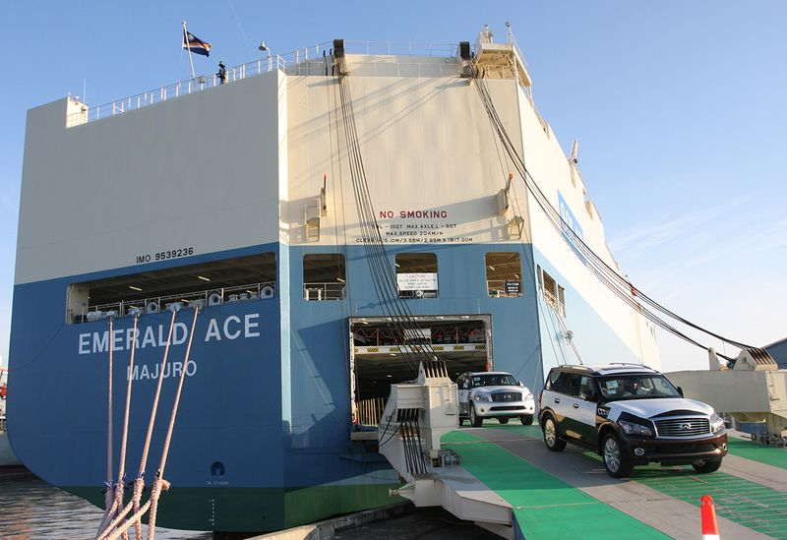
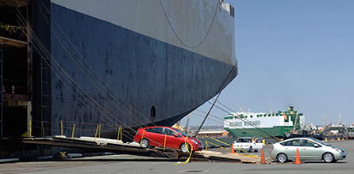
Custom Documentation & Vehicle Collection From Port
111111111111111111111111111111111111111111111111111111111111111111111
11111111111111111111111111111111111111111111111111111111111111111111111111
KAR Strengths & Capabilities
KAR FREIGHT & FORWARDING LLC

Slide 21
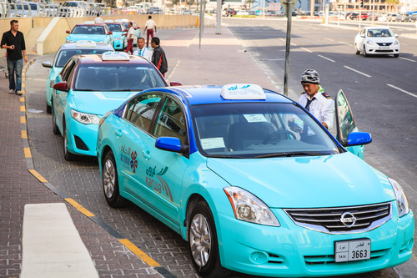
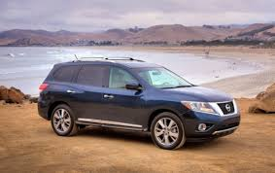
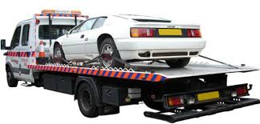
UAE & GCC Deliveries for Spare Parts & Vehicles
111111111111111111111111111111111111111111111111111111111111111111111
11111111111111111111111111111111111111111111111111111111111111111111111111
QATAR
OMAN
BAHRAIN
& KSA
GCC Countries
KAR Strengths & Capabilities
KAR FREIGHT & FORWARDING LLC

Slide 22
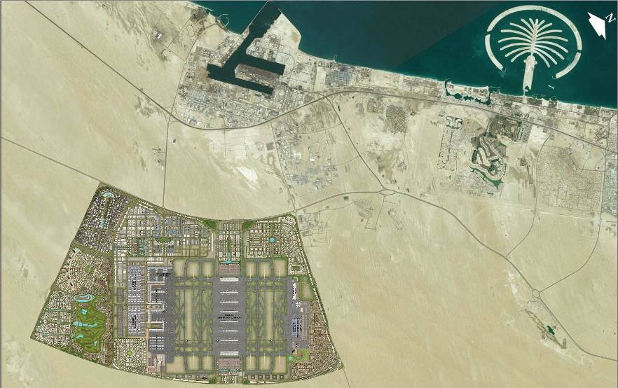
KAR FF Strengths & Capabilities
FZE Facilities
1111111111111111111111111111111111111111111111111111111111111111111111111111111111111111111111111
1111111111111111111111111111111111111111111111111111111111111111111111111111111111111111111111111
Jebel Ali Port
Warehouse No.1
space: 15,000㎡
storage: 7,200㎡
yard: 1,400㎡
Jebel Ali Free Zone
Warehouse No.2
(u/c)
space: 45,863㎡
storage:20,500㎡
yard: 6,000㎡
Main road Port – DLC
(bonded, within Free Zone)
Dubai
Logistics
City
Dubai World Central International Airport
=Al Maktoum International Airport
KAR FREIGHT & FORWARDING LLC

Slide 23
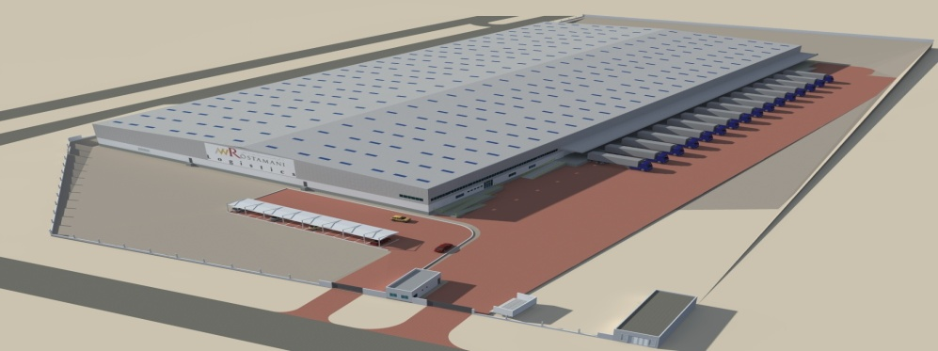
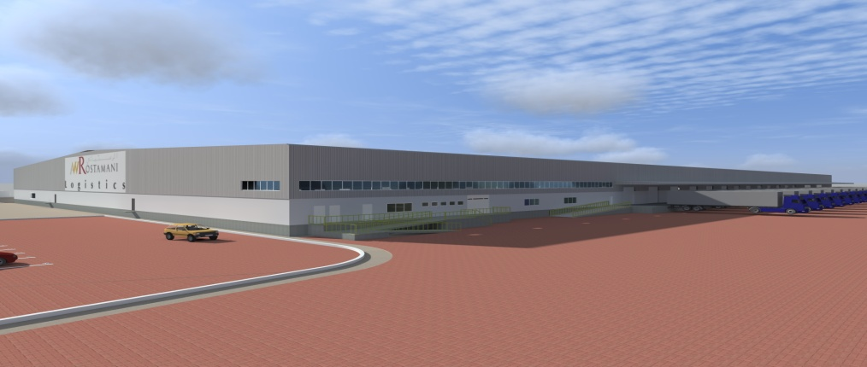
Facilities FZE AWR Logistics operates a new warehouse to meet your needs at Jebel Ali Free Zone south area. The location is ideal point between Jebel Ali Port, which is world 6th largest container port and Al Makutum International Airport. We provide the Warehouse Management System with barcode control and set up Rack System in the warehouse. Specifications : Reinforced concrete Space : 45,863M2 Warehouse Area : 20,517M2 Open yard Area : 6,000M2
Facilities FZE
AWR Logistics operates a new warehouse to meet your needs at Jebel Ali Free Zone south area. The location is ideal point between Jebel Ali Port, which is world 6th largest container port and Al Makutum International Airport.
We provide the Warehouse Management System with barcode control and set up Rack System in the warehouse. Specifications : Reinforced concrete Space : 45,863M2 Warehouse Area : 20,517M2 Open yard Area : 6,000M2
111111111111111111111111111111111111111111111111111111111111111111111111111111111111111111111111
1111111111111111111111111111111111111111111111111111111111111111111111111111111111111111111111 1111
KAR Strengths & Capabilities
KAR FREIGHT & FORWARDING LLC

Slide 24
About KAR FF - Business Processes & SOP
Standard Operating Procedure
Air Bound
Air Outbound
Sea Inbound
Sea Outbound
AAAAAAAAAAAAAAAAAAAAAAAAAAAAAAAAAAAAAAAAAAAAAAAAAAAAAAAAAAAAAAAAAAAAAAAAAAAAAAAAAA
Enquiries & Quote
Acceptance & obtaining of LPO, Job Order initiation
PDCA
Job Completion & Invoicing
Enquiries & Quote
Acceptance & obtaining of LPO, Job Order initiation
PDCA
Job Completion & Invoicing
KAR FREIGHT & FORWARDING LLC

Slide 25
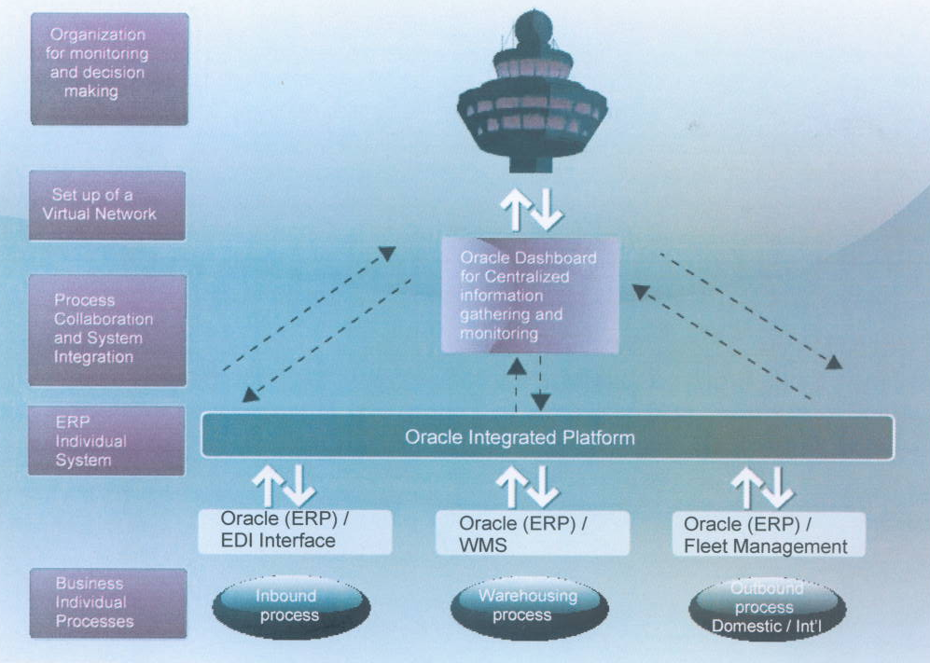
About KAR FF – Control Tower
CONTROL TOWER SYSTEM @ KAR FF
1111111111111111111111111111111111111111111111111111111111111111111111111111111
11111111111111111111111111111111111111111111111111111111111111111111111111111111
KAR FREIGHT & FORWARDING LLC

Slide 26
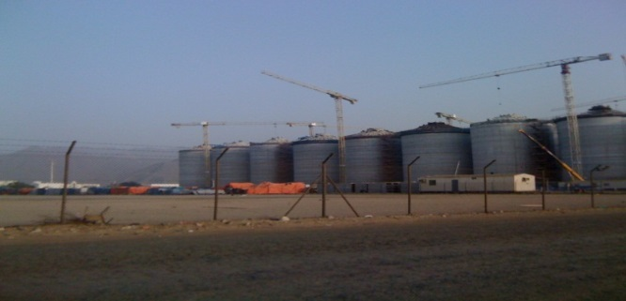
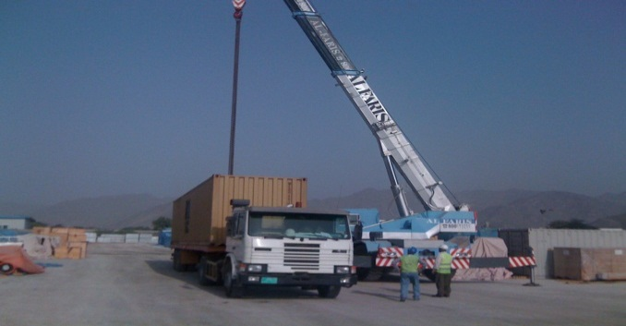
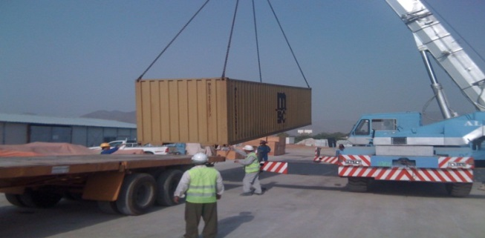
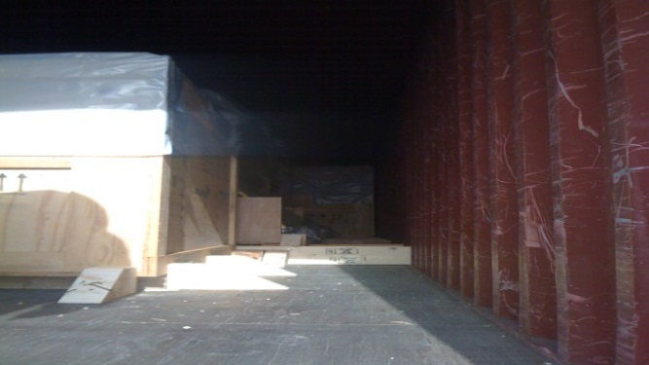
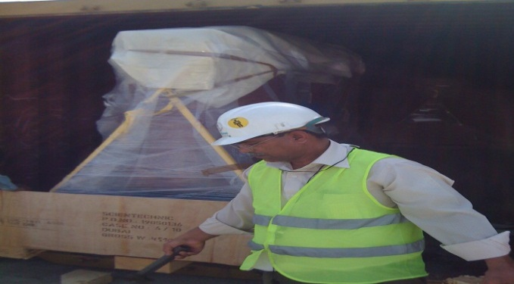
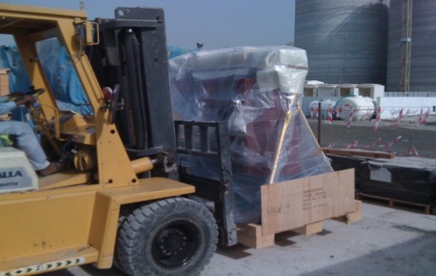
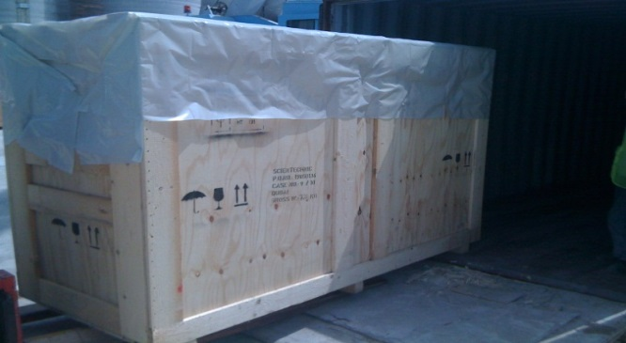
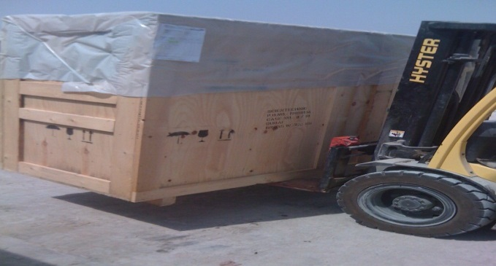
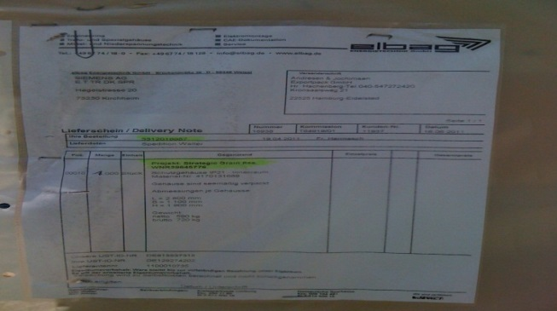
CHINA HARBOR PROJECT IN FUJAIRAH K.A.R TRANSPORT LLC, ARRANGED COMPLETE SUPPLY CHAIN SOLUTION EX-SUPPLIER WAREHOUSE TO DESTINATION DELIVERY YARD OF CONSIGNEE.
111111111111111111111111111111111111111111111111111111111111111111111
11111111111111111111111111111111111111111111111111111111111111111111111111
Synopsis of Jobs / Project Undertaken / Executed
KAR FREIGHT & FORWARDING LLC

Slide 27
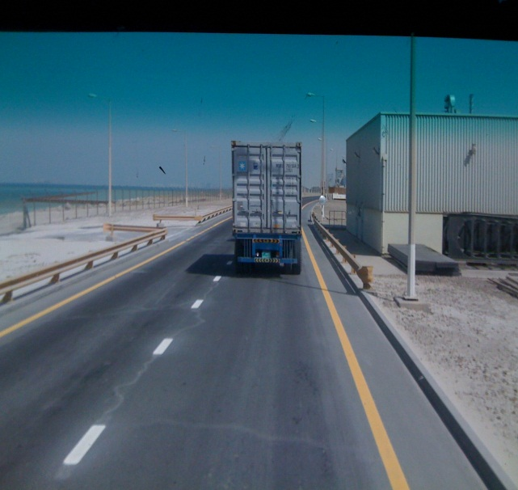
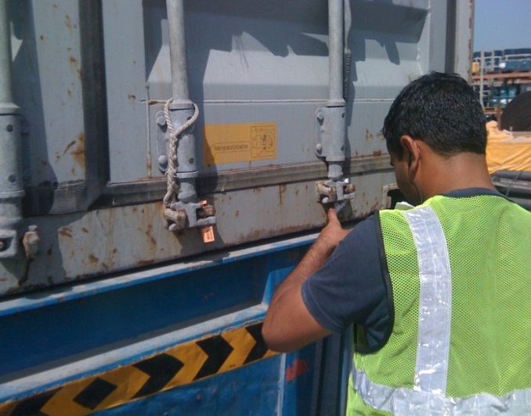
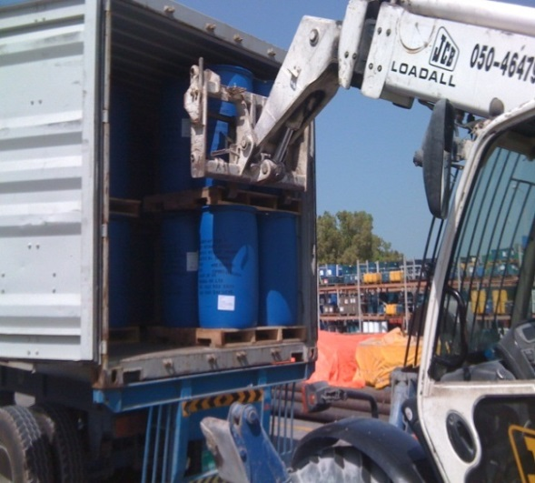
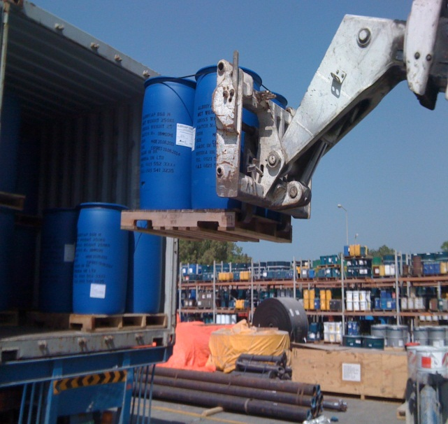
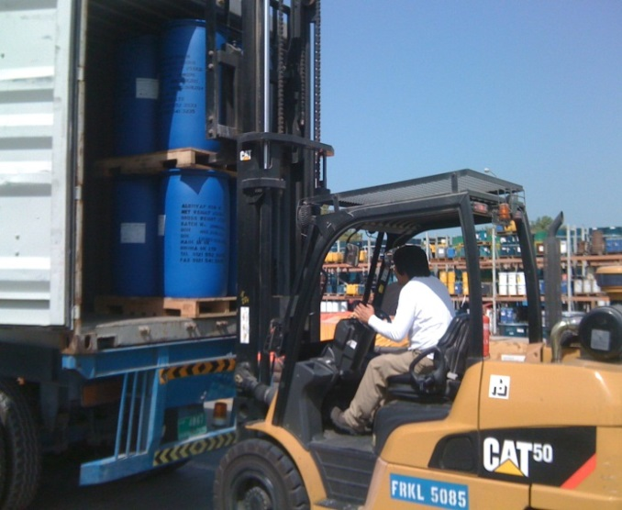
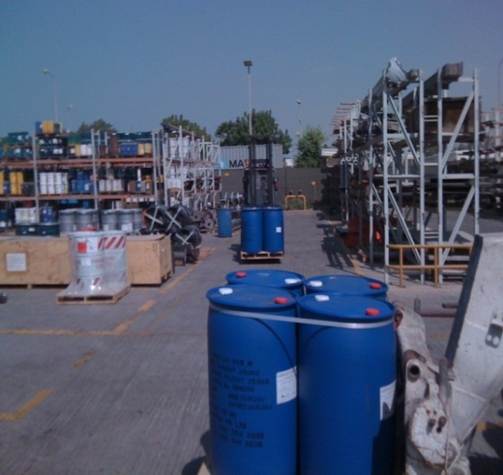
ALBRIVAP CHEMICALS DELIVERY AT DUBAL-JABEL ALI, DEWA JABEL ALI, FEWA SITES IN SHARJAH & SEWA SITES WITH F-LIFT, BOOM LOADER
111111111111111111111111111111111111111111111111111111111111111111111
11111111111111111111111111111111111111111111111111111111111111111111111111
Synopsis of Jobs / Project Undertaken / Executed
KAR FREIGHT & FORWARDING LLC

Slide 28
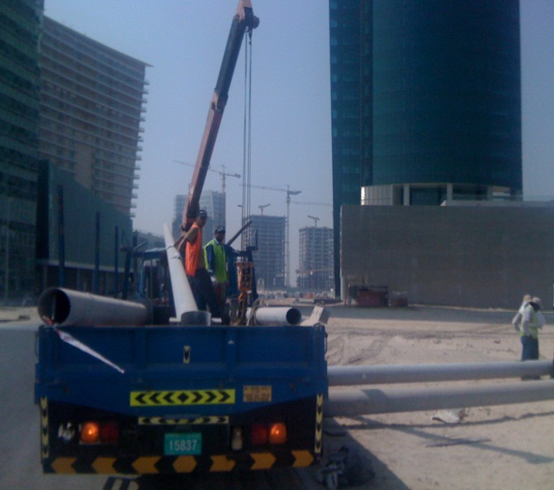
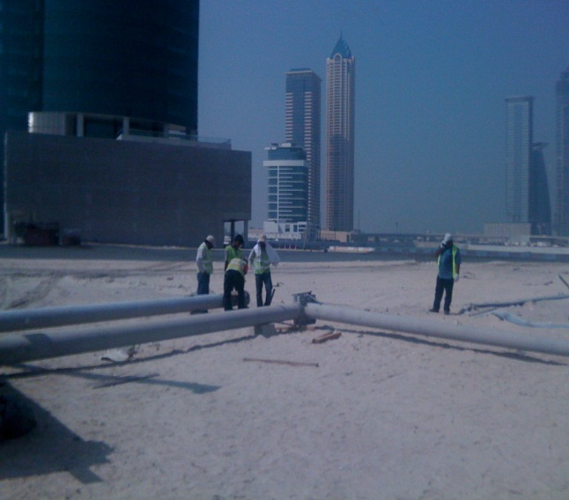
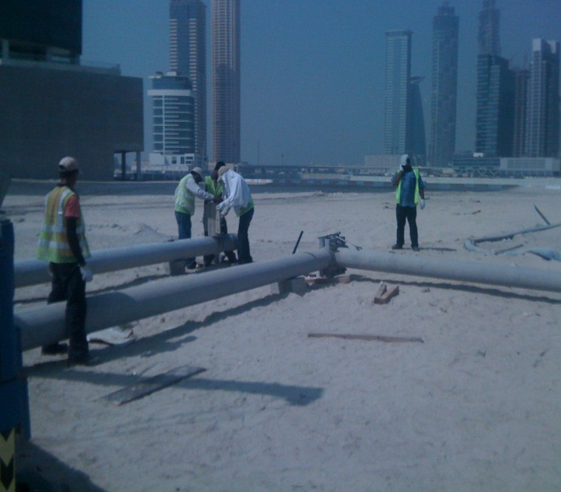
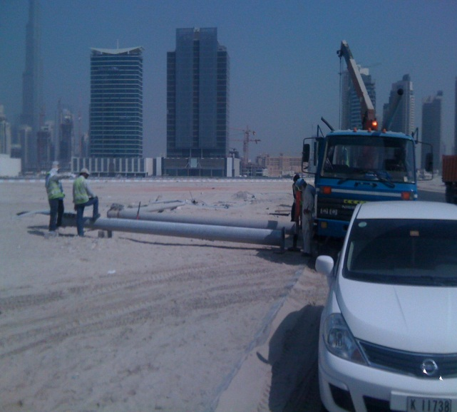
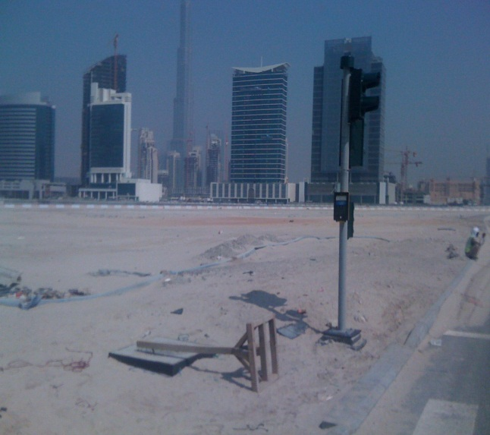
INSTALLATION OF TRAFFIC SIGNALS AT DOWNTOWN BURJ KHALIFA, USING 7 TONS PICKUP WITH BUILT IN CRANES
111111111111111111111111111111111111111111111111111111111111111111111
11111111111111111111111111111111111111111111111111111111111111111111111111
Synopsis of Jobs / Project Undertaken / Executed
KAR FREIGHT & FORWARDING LLC

Slide 29
TOP CUSTOMERS
KAR FREIGHT & FORWARDING LLC

Slide 30
ADVANTAGES OF PARTNERING WITH KAR TRANSPORT, LLC
We've built our reputation on delivering outstanding solutions that meet the specific needs of our clients,
for example:
* End to end supply chain solutions
* Managing consumer goods warehouses
* Supplying time-sensitive consignments on time
* Our Operations Excellence approach means implementation is quicker and less risky , your operations are more efficient, flexible and consistent; and you get the right metrics for better management.
* Providing impeccable after-sales service that brings you competitive advantage at a commercial rate.
* Tailored solutions based on proven best practice
* Range of specialized solutions that enable you to maintain a controlled, cost-effective production flow.
* Unsurpassed sector knowledge and logistics expertise to design and implement the right solutions for your business.
* Keeping your customers satisfied and your costs under control and that's how “KAR TRANSPORT, LLC ” logistics expertise can help your business.
KAR FREIGHT & FORWARDING LLC

Slide 31
CONTACTS & INFO
KAR Freight & Forwarding LLC
P.O Box 114744, Dubai, UAE
T +971 - 4 - 602 5100
F +971 - 4 - 602 5111
m.shahab@karfreight.com
KAR GROUP
KAR FREIGHT & FORWARDING LLC,
KAR TRANSPORT LLC
KAR FREIGHT & FORWARDING LLC

